Slide 1
OPERATION ACTIVE RESOLVE (OPAR)
Road to war and situation
CAO: 2021-08-22
Version: 2.0
Notes:
Changes:
1.1: Minor updates to correct the brief IAW actual situation.

Slide 2
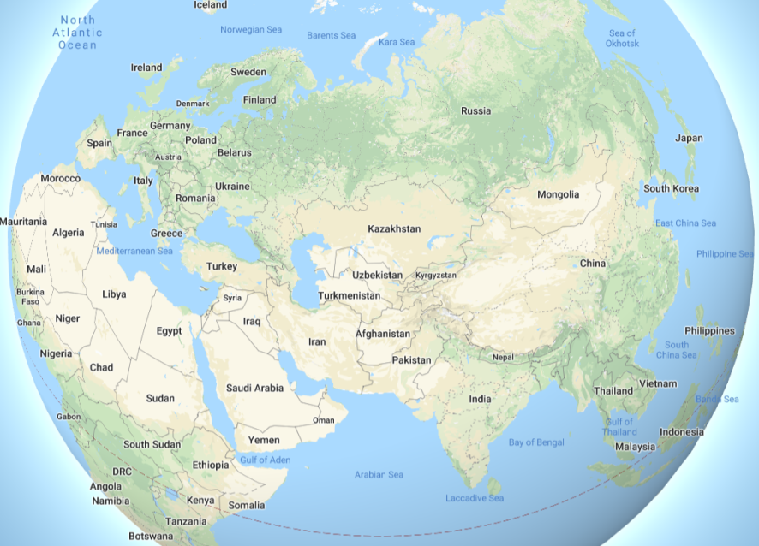
GLOBAL SITUATION
Europe:
Russia have been threatening to invade Baltic countries as a response to NATO actions. NATO have deployed forces to the Baltic to reinforce the country and deter a Russian attack.
Asia:
After months of deteriorating in relations between US and China, the situation escalated a few weeks ago with fighting breaking out between Chinese and US fleets in the South China Sea.
While both sides are trying to contain the conflict and prevent it from escalating, both China and the US has been reinforcing their bases in the region.
Russia has declared its full support in Chinese territorial claims and condemned US "Western intervention in Asia's affairs“
As of this time there's no clear end to the conflict and we can expect the US to focus its attention - both in the diplomatic arena as well as the prioritization of military and economical assets - in South-East Asia rather than the Middle-East.
Diplomatic:
Due to the current situation in Europe and Asia, Russia and China are boycotting the United Nations Security Council.
SOUTH CHINA SEA
BALTIC
OPAR AREA OF OPERATIONS
Middle East (OPAR Area of Operations)
See next slides

Slide 3
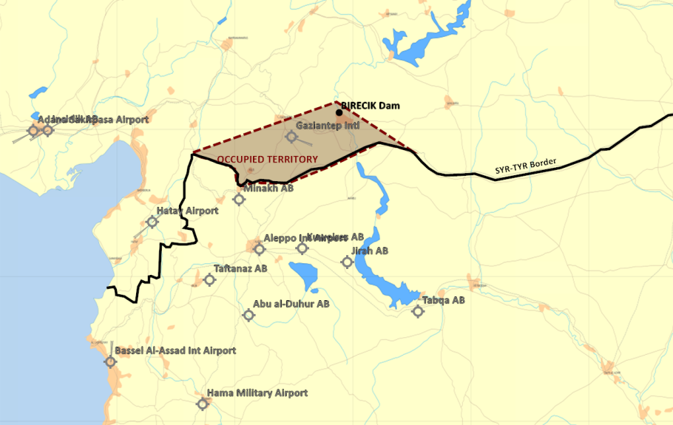
SITUATION & TIMELINE
Time now: Last week of august 2011.
1st July 2011 , Syria conducted a surprise attack against Turkey in order to seize control of the Birecik Dam.
Syrian objectives in Turkey is assessed to be
  Seize control of the Birecik dam to gain a strategic advantage by controlling the source of fresh water and electrical power in the area.
  Gaziantep airport is occupied to deny Turkey an airport which can be used to receive supplies/reinforcements closest to the occupied territory
  Syria will likely consolidate the occupied territory without attacking the city of Gaziantep.
At the same time Syria also conducted a surprise test of its chemical weapon
  It is assessed as a sign of resolve and show of force from Syrian government, the test likely aimed toward Turkey and NATO
Syria also mobilized its 3rd Corps of the border of Israel to protect Damascus from any action from Israel
2nd July: NATO & EU expressed support to Turkey and condemned the Syrian attack.

Slide 4
SITUATION & TIMELINE
5th of July: UN Security Council (UNSC) expressed concern on the situation and asked the parties to end the violence and resolve the conflict with diplomatic means.
7th of July: After a week of fighting, the Syrian forces effectivly defeated Turkish forces and are now in control of its main objectives (Birecik Dam and Gaziantep airport )
8th of July: Turkey called for a UN Security Council Resolution for Syria to withdraw from the occupied territory
10th of July: UN Security Council released resolution 3263: S/RES/3263 (2011) which states that Syrian action is against international law, and Syria should return its forces back to the borders from before 1st August. The resolution also call on Syria to allow inspectors from UN to inspect the chemical weapon program
14th of July: UN Security Council released resolution 3266: S/RES/3266 (2011) which reaffirmed UNSCR 3263 and imposed economic sanctions against Syria to make it comply with UNSCR 3263.
15th July: A coalition of the willing is beeing formed. Combined Joint Task Force 82 is created to form the international response to support Turkey against Syrian aggression.
1st August: UN Security Council released resolution 3274: S/RES/3274 (2011) which gave Syria a deadline of 31st August 2011 to comply with UNSCR 3263 and withdraw from Turkey and stop all chemical weapons testing. The resolution empowered states to use "all necessary means" to force Syria out of Turkey and to stop Syria from using chemical weapons after the deadline.
Throughout August: CJTF builds up combatpower in the region. Syria prepares defensive positions and the situation is static while the time toward the deadline is counting down. Syria used the august effectively and resupplied its military forces so their forces are fully equipped and combat ready.

Slide 5
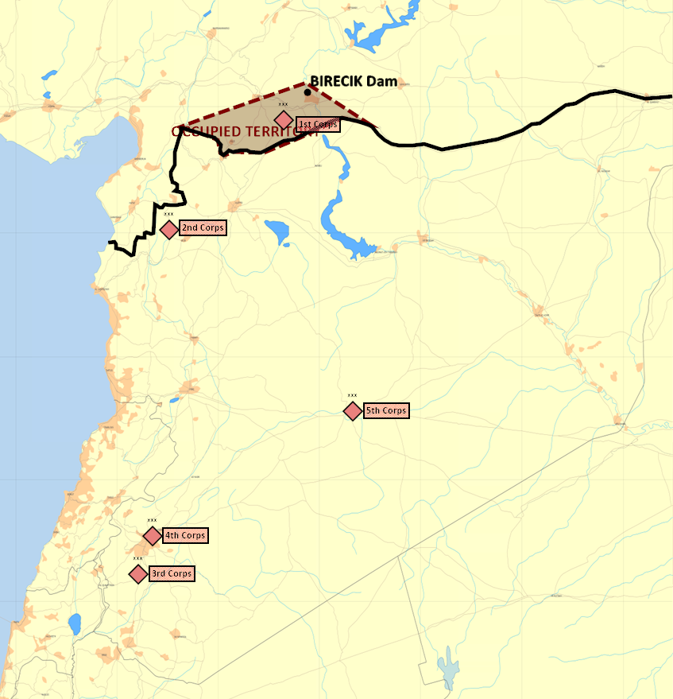
MILITARY SITUATION
Syria ground force dispositions is as follows:
  1st Corps have seized the occupied territory and are in defensive positions to defend Syrias newly seized area.
  2nd Corps have left their bases and are lining up on the border to the north in defensive positions
  3rd Corps have mobilized and are established in defensive positions along the border to Israel
  4th Corps are conducting rear duty assignments and protecting Damascus
  5th Corps are in their base in Palmyra, finishing their workup to be prepared for operations.
  Air Forces IAW INTREP VIS OPAR-003 - Syrian Air Force
  Syrian strategic IADS IAW: INTREP VIS OPAR-002 - Syrian IADS
  For details see intelligence page on OPAR briefing page: OPAR Intelligence

Slide 6
ACTORS - Allied
Turkey
Slowly recovering from a financial crisis affecting military combat readiness which manifests as:
  Difficulties maintaining qualified personnel
  Deterioration of equipment due to maintenance difficulties
  Limited national reserves of consumables needed for combat activity
Israel
The Israeli Defense Force (IDF) has been has been undergoing a slow transformation since the 2006 war in Lebanon. More effort spent on training for counter-guerrilla scenarios and reduced focus on large-scale combat scenarios as are expected against the Syrian armed forces.
Israeli air-force (IAF) have conducted a limited number of air attacks in Syria against strategic targets (Iranian targets and Syrian targets) the last decade.
Along the Lebanese border, the IDF is engaged in constantly high level of tension facing Hezbollah in Southern-Lebanon

Slide 7
ACTORS - Neutral
Lebanon
Enjoys good relations with Syria
Have had a neutral stance toward Israel the recent years.
However, Hezbollah is based in Lebanon
Jordan
Jordan have currently not taken any sides in the conflict and have expressed discontent with the Syrian invasion, but have not gone so far to condemn it, or to support CJTF operations.

Slide 8
ACTORS - Adversaries
Syria
The Syrian leadership party has gone weaker in past months and is seeking to re-affirm itself as strong and aggressive by pursuing a militant stance.
With intent to gain access to more economical assets and becoming a dominant , regional superpower, Syria set an ambitious goal to launch a major military campaign against its historical enemies in Turkey.
This approach become more appealing with the US being occupied with its conflict with China and lack of apparent interest in Middle-East affairs
In the recent years, Syria has been hosting large numbers of foreign military units:
  Russian air force has been staging in Syrian airbases as part of a strategic agreement of providing Russia with a naval base and part of a airfield
  Iranian revolutionary guards are very active in establishing bases to be used for possible operations against Israel in the event of a conflict between the two countries. Those bases and efforts have been the targets of numerous air raids by Israeli air force.

Slide 9
ACTORS – Adversaries
Iran
Iran also seeks to increase its influence in the region. Iran aspires to achieve a status of dominant power. Iran invests effort in building capabilities against Israel in the following areas:
Build deterrence against Israel by staging forces close to Israeli border. Such force can include ballistic missiles as well as militants which would can be used to retaliate against Israel
Supporting Hezbollah in military equipment, training camps and funding to be used as an additional deterrence tool against Israel
Hezbollah
Hezbollah is maintaining presence in Southern Lebanon and in the Syrian side of the Golan-Heights to inflict pressure on Israel and deter against possible Israeli incursions into Lebanon (Although not initiating escalation of the situation without specific instructions of support from Iran)
Russia
Russia has its strategic interests in Syria:
The TARTUS naval base (Russian's only major port in the Eastern Mediterranean) operated by Russian personnel (advisors and fleet shipyard) and defended by SAM units manned by Russian servicemen.
The presence of military advisors and aerial assets used for infliction of power and influence in the Middle East
Bassel Al-Assad Airport is the airbase used for Russian operations in the middle east. The last months there have only been sporadic Russian activity at the base.
China
Currently unknown if China have any interest in the campaign in Syria. However, likely that CHINA will use any mean necessary to undermine coalition effort throughout the world

